Slide 1
Employee Data Analysis using Excel
STUDENT NAME:ISHWARYA M
REGISTER NO:312215008
DEPARTMENT:COMMERCE(B.COM)
COLLEGE SOKA IKEDA COLLEGE OF ARTS AND SCIENCE FOR WOMEN

Slide 2
PROJECT TITLE
Employee Performance Analysis using Excel

Slide 3


AGENDA
Problem Statement
Project Overview
End Users
Our Solution and Proposition
Dataset Description
Modelling Approach
Results and Discussion
Conclusion
3/21/2024 Annual Review

Slide 4

PROBLEM STATEMENT
Data Collection and Organization: Collect employee performance data, including metrics such as sales figures, project completion rates, customer feedback scores, and attendance records.

Slide 5

PROJECT OVERVIEW
.
Data Collection: Gather performance data, which may include metrics such as sales numbers, customer feedback, project completion rates, attendance records, and any other relevant KPIs (Key Performance Indicators

Slide 6

WHO ARE THE END USERS?
Human Resources (HR) Professionals: HR teams use performance analysis to assess employee performance, identify areas for development, and make decisions regarding promotions or terminations
Managers and Team Leaders: They use performance data to evaluate team members, provide feedback, and manage performance improvement plans.

Slide 7

OUR SOLUTION AND ITS VALUE PROPOSITION
Condition formatting
Filter
Pivot table
Formula

Slide 8
Dataset Description
We took the employee datas from kaggle website.
We have 26 features totally.But, We used only 9 of the features.
We entered the name of the employees in Alphabetical order. And we also enterd the employee type in Alphabetical order.
We entered the performance level of the employee in Numerical value.
We entered the gender of the employees as Male/Female.
We entered the data of employee rating in Numerical value.
We entered the Business unit in Alphabetical order.

Slide 9

THE "WOW" IN OUR SOLUTION
=IFS(Z8>=5,"VERY HIGH",Z8>=4,"HIGH",Z8>=3,"MEDIUM",TRUE,"LOW")
The above formula used to catagorize the performance level of the employees is considered as “WOW” in my project.
3/21/2024 Annual Review
9

Slide 10
MODELLING
Collect Data Input Sources: Gather data from performance reviews, sales reports, attendance logs, etc. Format: Ensure data is in a structured format (e.g., spreadsheets with rows for employees and columns for metrics).
Set Up Excel Spreadsheet Data Sheet: Create a sheet where raw data is input. Columns might include Employee ID, Name, Department, Metrics (e.g., Sales, Quality, Attendance
10

Slide 11
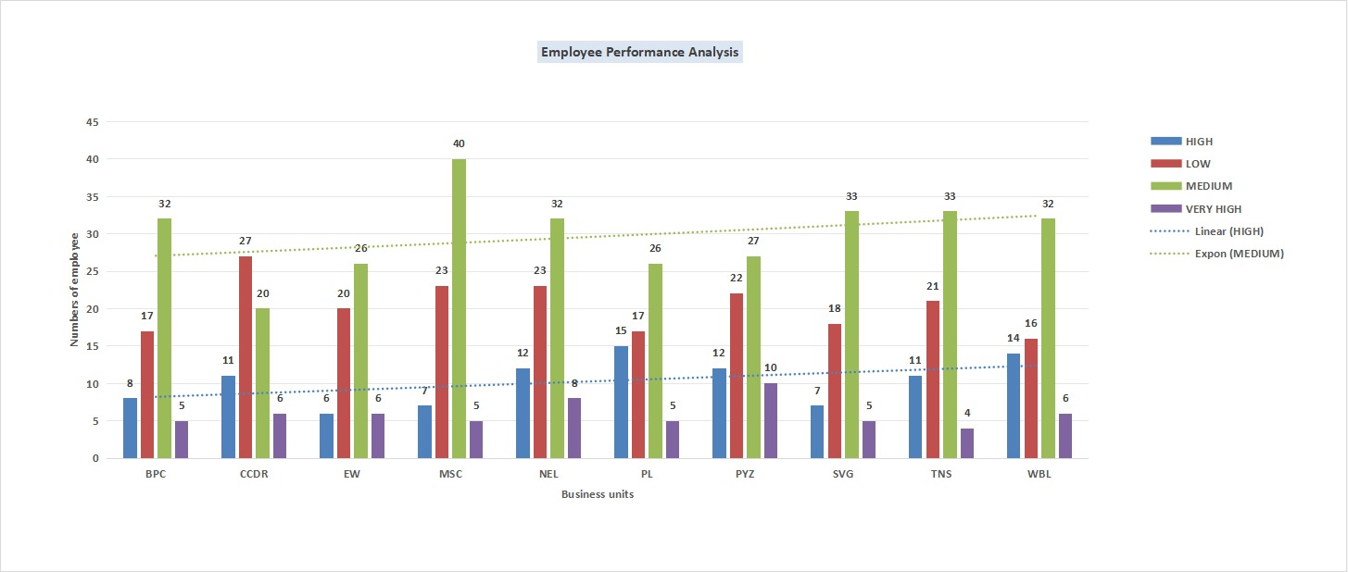
RESULTS
11

Slide 12
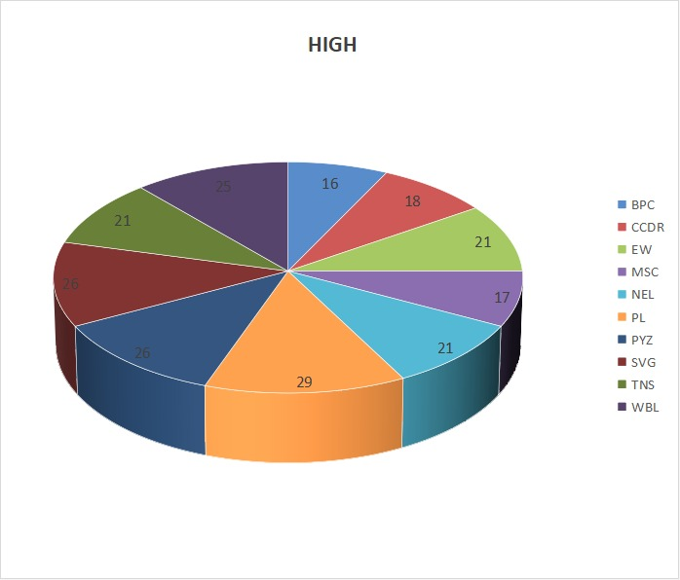
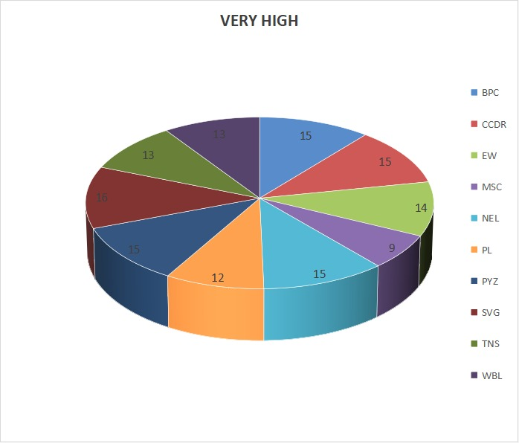

Slide 13
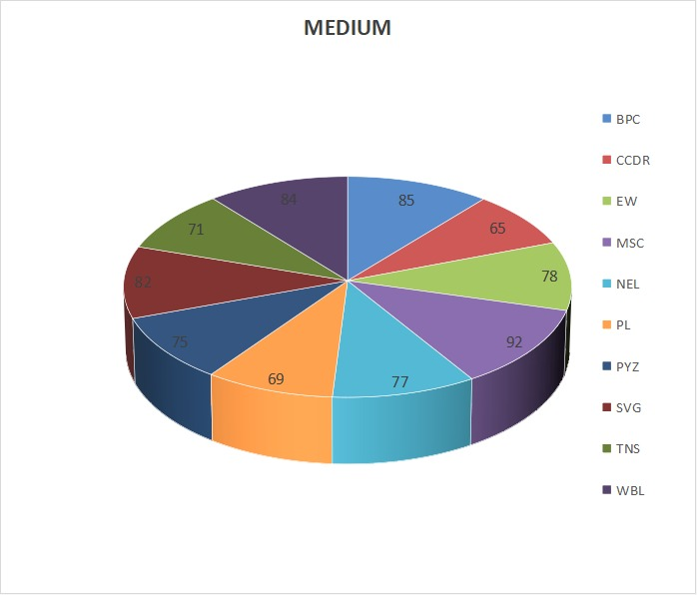
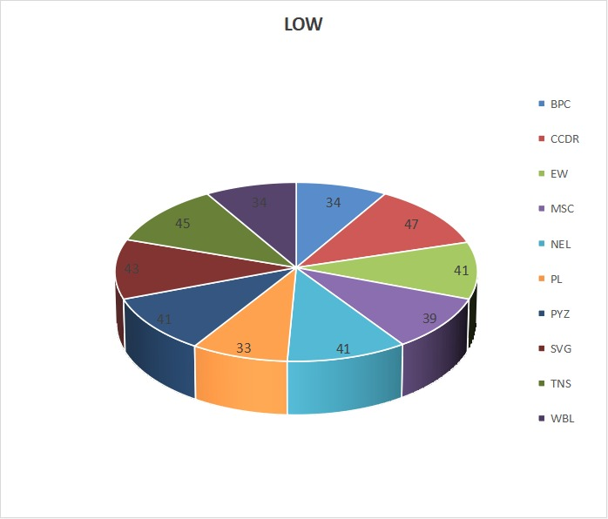

Slide 14
CONCLUSION :-
1.In overall, Majority Employees got “Medium” level in their performance. 2. Employees in PL business unit got majority “High” level performance rating. 3. Employees in SVG have got majority “Very high” level performance rating. 4. In CCDR, majority employees got “low” level ratings. 5. In MSC business unit, majority employees got “Medium” level performance rating.

